Slide 1
Introduction to Classes and Objects

Slide 2
Topics
7.1 Abstract Data Types
7.2 Object-Oriented Programming
7.3 Introduction to Classes
7.4 Creating and Using Objects
7.5 Defining Member Functions
7.6 Constructors
7.7 Destructors
7.8 Private Member Functions
7.9 Passing Objects to Functions
7.10 Object Composition
7.11 Separating Class Specification, Implementation, and Client Code

Slide 3
7.1 Abstract Data Types
Are programmer-created data types that specify
the legal values that can be stored
the operations that can be done on the values
The user of an abstract data type (ADT) does not need to know any implementation details (e.g., how the data is stored or how the operations on it are carried out)

Slide 4
Abstraction in Software Development
Abstraction allows a programmer to design a solution to a problem and to use data items without concern for how the data items are implemented
This has already been encountered in the book:
To use the pow function, you need to know what inputs it expects and what kind of results it produces
You do not need to know how it works

Slide 5
Abstraction and Data Types
Abstraction: a definition that captures general characteristics without details
ex: An abstract triangle is a 3-sided polygon. A specific triangle may be scalene, isosceles, or equilateral
Data Type: defines the kind of values that can be stored and the operations that can be performed on the values

Slide 6
7.2 Object-Oriented Programming
Procedural programming focuses on the processes/ actions that occur in a program. Data and functions are separate and distinct.
Object-oriented programming is based on objects that encapsulate the data and the functions that operate with and on the data.

Slide 7
Limitations of Procedural Programming
Use of global data may allow data corruption
Programs are often based on complex function hierarchies
difficult to understand and maintain
difficult to modify and extend
easy to break

Slide 8
Object-Oriented Programming Terminology
class: similar to a struct
Allows bundling of related variables (member data) and the functions that operate on them (member functions)
Describes the properties that all instances of the class will have
object: an instance of a class, in the same way that a variable can be an instance of a struct

Slide 9
Object-Oriented Programming Terminology
attributes: the data items of an object, stored in member variables
member functions (methods): procedures/ functions that act on the attributes of the class

Slide 10
More Object-Oriented Programming Terminology
data hiding: restricting data access to certain members of an object.
Protection –provide a layer of protection against inadvertent or deliberate data corruption
Need-to-know –the programmer needn’t worry about implementation details when writing “client” code
encapsulation: the bundling of an object’s data and procedures into a single entity

Slide 11
Object Example
Square
Member variables (attributes)
int side;
Member functions
void setSide(int s)
int getSide()
Square object’s data item: side
Square object’s functions: setSide - set the size of the side of the square, getSide - return the size of the side of the square

Slide 12
7.3 Introduction to Classes
Class: a programmer-defined data type used to define objects
It is a pattern for creating objects
ex:
string fName, lName;
This creates two objects of the string class

Slide 13
Introduction to Classes
A class declaration describes the member variables and member functions that its objects will have
It is a pattern for creating objects
declaration format:
class className
{
declaration;
declaration;
};
Note the required ;

Slide 14
Access Specifiers
Used to control access to members of the class.
Each member is declared to be either
public: can be accessed by functions
outside of the class
or
private: can only be called by or accessed
by functions that are members of
the class

Slide 15
Class Example
class Square
{
private:
int side;
public:
void setSide(int s)
{ side = s; }
int getSide()
{ return side; }
};
Access specifiers

Slide 16
More on Access Specifiers
Can be listed in any order in a class
Can appear multiple times in a class
If not specified, the default is private

Slide 17
7.4 Creating and Using Objects
An object is an instance of a class
It is defined just like other variables
Square sq1, sq2;
It can access members using dot operator
sq1.setSide(5);
cout << sq1.getSide();
Notes:
See pr7-01.cpp

Slide 18
7.5 Defining Member Functions
Member functions are part of a class declaration
Place entire function definition inside the class declaration,
or
Place just the prototype inside the class declaration and write the function definition after the class

Slide 19
Types of Member Functions
Acessor, get, getter function: uses but does not modify a member variable
ex: getSide
Mutator, set, setter function: modifies a member variable
ex: setSide

Slide 20
Defining Member Functions Inside the Class Declaration
Member functions defined inside the class declaration are called inline functions
Only very short functions, like the one below, should be inline functions
int getSide()
{ return side; }

Slide 21
Inline Member Function Example
class Square
{
private:
int side;
public:
void setSide(int s)
{ side = s; }
int getSide()
{ return side; }
};
inline functions

Slide 22
Defining Member Functions After the Class Declaration *preferred way
Put a function prototype in the class declaration
In the function definition, precede the function name with the class name and scope resolution operator (::)
int Square::getSide()
{
return side;
}
Notes:
See pr7-02.cpp and pr7-03.cpp

Slide 23
Conventions and a Suggestion
Conventions:
Member variables are usually private
Accessor and mutator functions are usually public
Use ‘get’ in the name of accessor functions, ‘set’ in the name of mutator functions
Suggestion: If possible, use member variables to calculate a value to be returned, as opposed to storing the calculated value. This minimizes the likelihood of stale data.

Slide 24
Tradeoffs of Inline vs. Regular Member Functions
When a regular function is called, control passes to the called function
the compiler stores return address of call, allocates memory for local variables, etc.
Code for an inline function is copied into the program in place of the call when the program is compiled
larger executable program, but
less function call overhead, hence faster execution

Slide 25
Design Considerations
Class should be designed to provide methods to store and retrieve data
In general, I/O should be done by functions that use class objects, rather than by class member functions (Exceptions can occur, as with a class designed to display a menu)

Slide 26
7.6 Constructors
A constructor is a member function Is can be used to initialize data members
It must be a public member function
It must be named the same as the class
It must have no return type
is automatically called when an object of the class is created
Notes:
See pr7-04.cpp and pr7-05.cpp

Slide 27
Constructor – 2 Examples
Inline: class Square { . . . public: Square(int s) { side = s; } . . . }; | Declaration outside the class: Square(int); //prototype //in class Square::Square(int s) { side = s; }

Slide 28
Another Default Constructor Example
class Square
{
private:
int side;
public:
Square(int s = 1) // default
{ side = s; } // constructor
// Other member
// functions go here
};
Has parameter
but it has a default value

Slide 29
Overloading Constructors
A class can have more than 1 constructor
Overloaded constructors in a class must have different parameter lists
Square();
Square(int);
Notes:
See pr7-06.cpp

Slide 30
The Default Constructor
Constructors can have any number of parameters, including none
A default constructor is one that takes no arguments either due to
No parameters or
All parameters have default values
If a class has any programmer-defined constructors, it should have a programmer - defined default constructor

Slide 31
Default Constructor Example
class Square
{
private:
int side;
public:
Square() // default
{ side = 1; } // constructor
// Other member
// functions go here
};
Has no
parameters

Slide 32
Another Default Constructor Example
class Square
{
private:
int side;
public:
Square(int s = 1) // default
{ side = s; } // constructor
// Other member
// functions go here
};
Has parameter
but it has a default value

Slide 33
Invoking a Constructor
To create an object using the default constructor, use no argument list and no ()
Square square1;
To create an object using a constructor that has parameters, include an argument list
Square square2(8);

Slide 34
7.7 Destructors
Are public member functions that are automatically called when objects are destroyed
The destructor name is ~className, e.g., ~Square
It has no return type
It takes no arguments
Only 1 destructor is allowed per class
(i.e., it cannot be overloaded)
Notes:
See pr7-07.cpp

Slide 35
7. 8 Private Member Functions
A private member function can only be called by another member function of the same class
It is used for internal processing by the class, not for use outside of the class
Notes:
See pr7-08.cpp

Slide 36
7.9 Passing Objects to Functions
A class object can be passed as an argument to a function.
When it is passed by value, the function makes a local copy of the object. The original object in calling environment is unaffected by actions in the function.
When passed by reference, the function can use ‘set’ functions to modify the object in the calling environment.
Notes:
See pr7-09.cpp

Slide 37
Notes on Passing Objects
Using a value parameter for an object can slow down a program and waste space
Using a reference parameter speeds up the program. It allows the function to modify data in the parameter, which may not be desirable.

Slide 38
Notes on Passing Objects
To save space and time while protecting parameter data that should not be changed, use a const reference parameter
void showData(const Square &s)
// header
In order for the showData function to call Square member functions, those functions must use const in their prototype and header:
int Square::getSide() const;

Slide 39
Returning an Object from a Function
A function can return an object
Square initSquare(); // prototype
Square s1 = initSquare();// call
The function must create an object
for internal use
to use with return statement

Slide 40
Returning an Object Example
Square initSquare()
{
Square s; // local object
int inputSize;
cout << "Enter the length of side: ";
cin >> inputSize;
s.setSide(inputSize);
return s;
}
Notes:
See pr7-10.cpp

Slide 41
7.11 Separating Class Specification, Implementation, and Client Code
Separating the class declaration, member function definitions, and the program that uses the class into separate files is considered good design.

Slide 42
Using Separate Files
Place the class declaration in a header file that serves as the class specification file. Name the file classname.h (for example, Square.h)
Place the member function definitions in a class implementation file. Name the file classname.cpp (for example, Square.cpp)This file should #include the class specification file.
A client program (client code) that uses the class must #include the class specification file and be compiled and linked with the class implementation file.
Notes:
See pr7-12.cpp, Rectangle.cpp, and Rectangle.h

Slide 43
Include Guard
Is used to prevent a header file from being included twice
Format:
#ifndef symbol_name
#define symbol_name
. . . (normal contents of header file)
#endif
symbol_name is usually the name of the header file, in all capital letters:
#ifndef SQUARE_H
#define SQUARE_H
. . .
#endif

Slide 44
#pragma once
This instructor prefers to use
#pragma once
at the beginning of the file, because it is too easy to forget the #endif

Slide 45
What Should Be Done Inside vs. Outside the Class
Class should be designed to provide functions to store and retrieve data
In general, input and output (I/O) should be done by functions that use class objects, rather than by class member functions
Notes:
See Rectangle.h, Rectangle.cpp, and pr7-12.cpp

Slide 46
7.10 Object Composition
This occurs when an object is a member variable of another object.
It is often used to design complex objects whose members are simpler objects
ex. (from book): Define a rectangle class. Then, define a carpet class and use a rectangle object as a member of a carpet object.
Notes:
See pr7-11.cpp

Slide 47
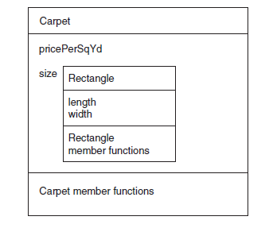
Object Composition, cont.

Slide 48
7.15 Introduction to Object-Oriented Analysis and Design
Object-Oriented Analysis: that phase of program development when the program functionality is determined from the requirements
It includes
identification of classes and objects
definition of each class's attributes
definition of each class's behaviors
definition of the relationship between classes

Slide 49
Identify Classes and Objects
Consider the major data elements and the operations on these elements
Candidates include
user-interface components (menus, text boxes, etc.)
I/O devices
physical objects
historical data (employee records, transaction logs, etc.)
the roles of human participants

Slide 50
Define Class Attributes
Attributes are the data elements of an object of the class
They are necessary for the object to work in its role in the program

Slide 51
Define Class Behaviors
For each class,
Identify what an object of a class should do in the program
The behaviors determine some of the member functions of the class

Slide 52
Relationships Between Classes
Possible relationships
Access ("uses-a")
Ownership/Composition ("has-a")
Inheritance ("is-a")

Slide 53
Finding the Classes
Technique:
Write a description of the problem domain (objects, events, etc. related to the problem)
List the nouns, noun phrases, and pronouns. These are all candidate objects
Refine the list to include only those objects that are relevant to the problem

Slide 54
Determine Class Responsibilities
Class responsibilities:
What is the class responsible to know?
What is the class responsible to do?
Use these to define some of the member functions

Slide 55
Object Reuse
A well-defined class can be used to create objects in multiple programs
By re-using an object definition, program development time is shortened
One goal of object-oriented programming is to support object reuse

Slide 56
Object-Based vs. Object-Oriented
A program that uses classes and objects is object-based.
An object-based program that
defines relationships between classes of objects
creates classes from other classes
determines member function behavior based on the object
is more likely to be an object-oriented program

Slide 57
Inheritance, Polymorphism, and Virtual Functions

Slide 58
What Is Inheritance?
Provides a way to create a new class from an existing class
The new class is a specialized version of the existing class

Slide 59
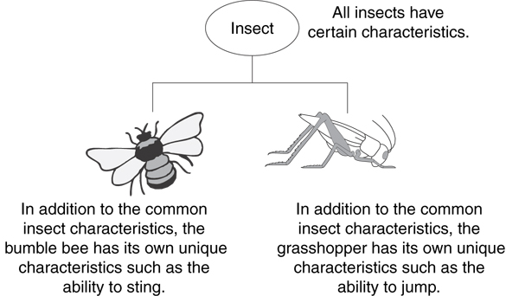
Example: Insect Taxonomy

Slide 60
The "is a" Relationship
Inheritance establishes an "is a" relationship between classes.
A poodle is a dog
A car is a vehicle
A flower is a plant
A football player is an athlete

Slide 61
Inheritance – Terminology and Notation in C++
Base class (or parent) – inherited from
Derived class (or child) – inherits from the base class
Notation:
class Student // base class
{
. . .
};
class UnderGrad : public Student
{ // derived class
. . .
};

Slide 62
Back to the ‘is a’ Relationship
An object of a derived class 'is a(n)' object of the base class
Example:
an UnderGrad is a Student
a Mammal is an Animal
A derived object has all of the characteristics of the base class

Slide 63
What Does a Child Have?
An object of the derived class has:
all members defined in child class
all members declared in parent class
An object of the derived class can use:
all public members defined in child class
all public members defined in parent class

Slide 64
Protected Members and Class Access
protected member access specification: like private, but accessible by objects of derived class
Class access specification: determines how private, protected, and public members of base class are inherited by the derived class

Slide 65
Class Access Specifiers
public – object of derived class can be treated as object of base class (not vice-versa)
protected – more restrictive than public, but allows derived classes to know details of parents
private – prevents objects of derived class from being treated as objects of base class.

Slide 66
Inheritance vs. Access
How inherited base class members
appear in derived class
Base class members
private: x
protected: y
public: z
private
base class
x is inaccessible
private: y
private: z
private: x
protected: y
public: z
protected
base class
x is inaccessible
protected: y
protected: z
private: x
protected: y
public: z
public
base class
x is inaccessible
protected: y
public: z

Slide 67
Inheritance vs. Access
class Grade
class Test : public Grade
private members:
char letter;
float score;
void calcGrade();
public members:
void setScore(float);
float getScore();
char getLetter();
private members:
int numQuestions;
float pointsEach;
int numMissed;
public members:
Test(int, int);
private members:
int numQuestions:
float pointsEach;
int numMissed;
public members:
Test(int, int);
void setScore(float);
float getScore();
char getLetter();
When Test class inherits
from Grade class using
public class access, it looks like this:

Slide 68
Inheritance vs. Access
class Grade
class Test : protected Grade
private members:
char letter;
float score;
void calcGrade();
public members:
void setScore(float);
float getScore();
char getLetter();
private members:
int numQuestions;
float pointsEach;
int numMissed;
public members:
Test(int, int);
private members:
int numQuestions:
float pointsEach;
int numMissed;
public members:
Test(int, int);
protected members:
void setScore(float);
float getScore();
float getLetter();
When Test class inherits
from Grade class using
protected class access, it looks like this:

Slide 69
Inheritance vs. Access
class Grade
class Test : private Grade
private members:
char letter;
float score;
void calcGrade();
public members:
void setScore(float);
float getScore();
char getLetter();
private members:
int numQuestions;
float pointsEach;
int numMissed;
public members:
Test(int, int);
private members:
int numQuestions:
float pointsEach;
int numMissed;
void setScore(float);
float getScore();
float getLetter();
public members:
Test(int, int);
When Test class inherits
from Grade class using
private class access, it looks like this:

Slide 70
Constructors and Destructors in Base and Derived Classes
Derived classes can have their own constructors and destructors
When an object of a derived class is created, the base class’s constructor is executed first, followed by the derived class’s constructor
When an object of a derived class is destroyed, its destructor is called first, then that of the base class

Slide 71
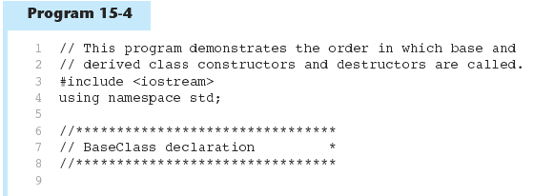
Constructors and Destructors in Base and Derived Classes

Slide 72
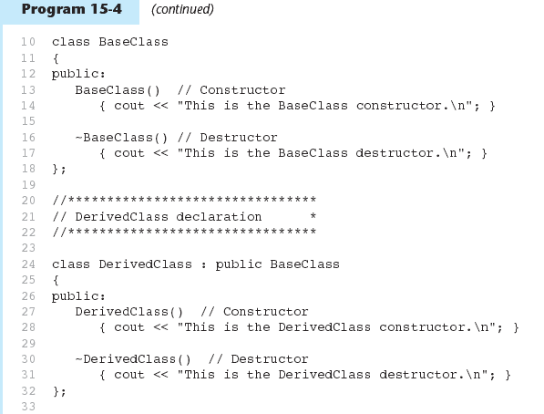
Constructors and Destructors in Base and Derived Classes

Slide 73
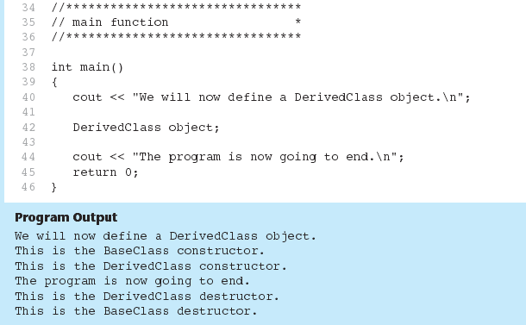
Constructors and Destructors in Base and Derived Classes

Slide 74
Passing Arguments to Base Class Constructor
Allows selection between multiple base class constructors
Specify arguments to base constructor on derived constructor heading:
Square::Square(int side) : Rectangle(side, side)
Can also be done with inline constructors
Must be done if base class has no default constructor

Slide 75
Passing Arguments to Base Class Constructor
derived class constructor
base class constructor
Square::Square(int side):Rectangle(side,side)
derived constructor parameter
base constructor parameters

Slide 76
Redefining Base Class Functions
Redefining function: function in a derived class that has the same name and parameter list as a function in the base class
Typically used to replace a function in base class with different actions in derived class

Slide 77
Redefining Base Class Functions
Not the same as overloading – with overloading, parameter lists must be different
Objects of base class use base class version of function; objects of derived class use derived class version of function

Slide 78
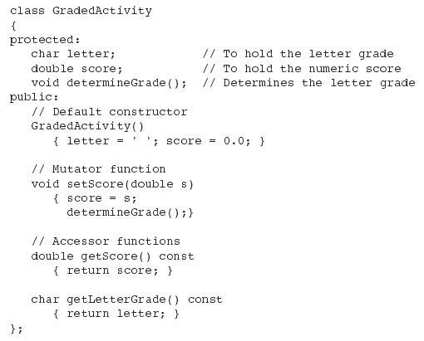
Base Class

Slide 79
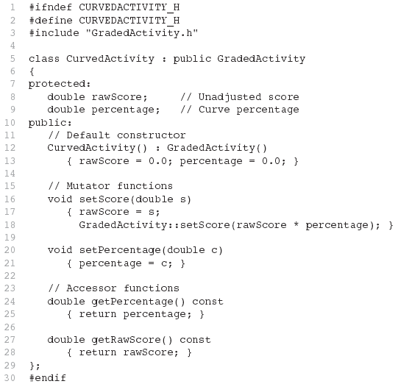
Derived Class
Redefined setScore function

Slide 80
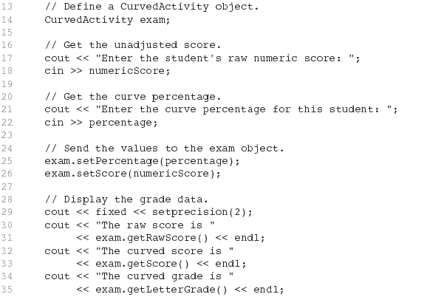
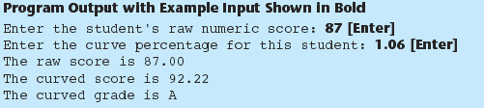
Driver Program

Slide 81
Problem with Redefining
Consider this situation:
Class BaseClass defines functions x() and y(). x() calls y().
Class DerivedClass inherits from BaseClass and redefines function y().
An object D of class DerivedClass is created and function x() is called.
When x() is called, which y() is used, the one defined in BaseClass or the the redefined one in DerivedClass?

Slide 82
Problem with Redefining
BaseClass
void X();
void Y();
Object D invokes function X()
In BaseClass. Function X()
invokes function Y() in BaseClass, not function Y() in DerivedClass,
because function calls are bound at compile time. This is static binding.
DerivedClass
void Y();
DerivedClass D;
D.X();

Slide 83
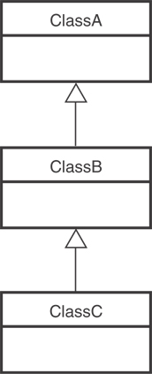
Class Hierarchies
A base class can be derived from another base class.

Slide 84
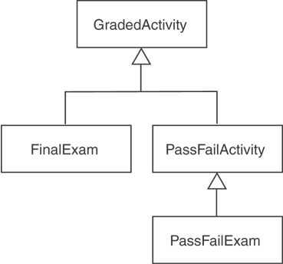
Class Hierarchies
Consider the GradedActivity, FinalExam, PassFailActivity, PassFailExam hierarchy in Chapter 15.

Slide 85
Polymorphism and Virtual Member Functions
Virtual member function: function in base class that expects to be redefined in derived class
Function defined with key word virtual:
virtual void Y() {...}
Supports dynamic binding: functions bound at run time to function that they call
Without virtual member functions, C++ uses static (compile time) binding

Slide 86
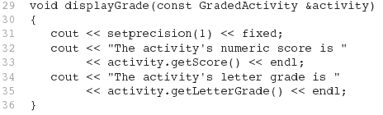
Polymorphism and Virtual Member Functions
Because the parameter in the displayGrade function is a GradedActivity reference variable, it can reference any object that is derived from GradedActivity. That means we can pass a GradedActivity object, a FinalExam object, a PassFailExam object, or any other object that is derived from GradedActivity.
A problem occurs in Program 15-10 however...

Slide 87
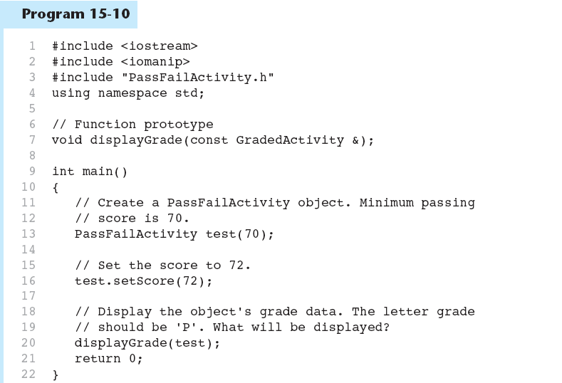

Slide 88
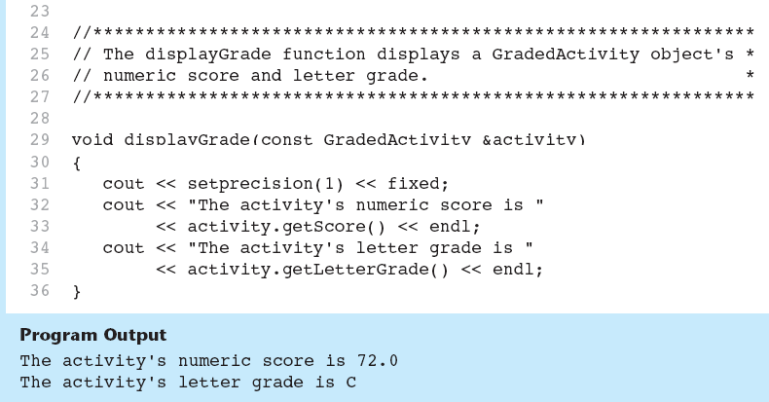
As you can see from the example output, the getLetterGrade member function returned ‘C’ instead of ‘P’. This is because the GradedActivity class’s getLetterGrade function was executed instead of the PassFailActivity class’s version of the function.

Slide 89
Static Binding
Program 15-10 displays 'C' instead of 'P' because the call to the getLetterGrade function is statically bound (at compile time) with the GradedActivity class's version of the function. We can remedy this by making the function virtual.

Slide 90
Virtual Functions
A virtual function is dynamically bound to calls at runtime. At runtime, C++ determines the type of object making the call, and binds the function to the appropriate version of the function.

Slide 91
Virtual Functions
To make a function virtual, place the virtual key word before the return type in the base class's declaration:
virtual char getLetterGrade() const;
The compiler will not bind the function to calls. Instead, the program will bind them at runtime.

Slide 92
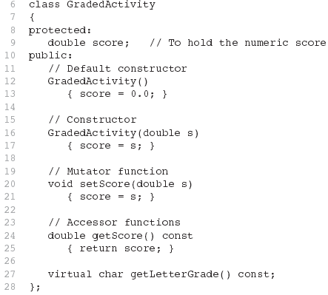
Updated Version of GradedActivity
The function is now virtual.
The function also becomes virtual in all derived classes automatically!

Slide 93

Polymorphism
If we recompile our program with the updated versions of the classes, we will get the right output, shown here: (See Program 15-11 in the book.)
This type of behavior is known as polymorphism. The term polymorphism means the ability to take many forms.
Program 15-12 demonstrates polymorphism by passing
objects of the GradedActivity and PassFailExam classes to the displayGrade function.

Slide 94
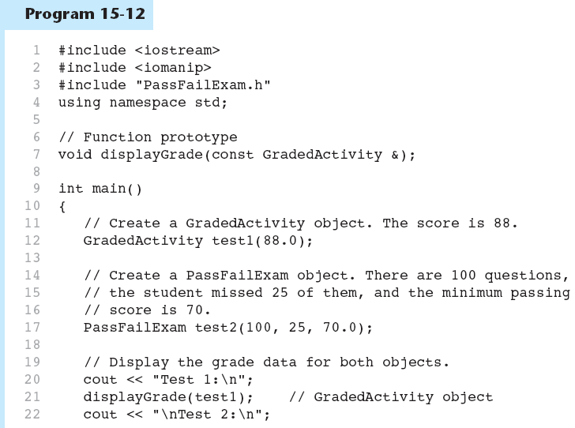

Slide 95
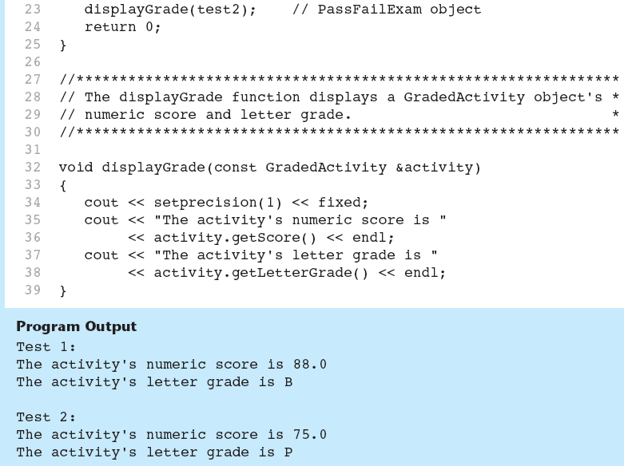

Slide 96
Polymorphism Requires References or Pointers
Polymorphic behavior is only possible when an object is referenced by a reference variable or a pointer, as demonstrated in the displayGrade function.

Slide 97

Base Class Pointers
Can define a pointer to a base class object
Can assign it the address of a derived class object

Slide 98
Base Class Pointers
Base class pointers and references only know about members of the base class
So, you can’t use a base class pointer to call a derived class function
Redefined functions in derived class will be ignored unless base class declares the function virtual

Slide 99
Redefining vs. Overriding
In C++, redefined functions are statically bound and overridden functions are dynamically bound. So, a virtual function is overridden, and a non-virtual function is redefined.

Slide 100
Virtual Destructors
It's a good idea to make destructors virtual if the class could ever become a base class.
Otherwise, the compiler will perform static binding on the destructor if the class ever is derived from.
See Program 15-14 for an example

Slide 101
Abstract Base Classes and Pure Virtual Functions
Pure virtual function: a virtual member function that must be overridden in a derived class that has objects
Abstract base class contains at least one pure virtual function:
virtual void Y() = 0;
The = 0 indicates a pure virtual function
Must have no function definition in the base class

Slide 102
Abstract Base Classes and Pure Virtual Functions
Abstract base class: class that can have no objects. Serves as a basis for derived classes that may/will have objects
A class becomes an abstract base class when one or more of its member functions is a pure virtual function

Slide 103
Multiple Inheritance
A derived class can have more than one base class
Each base class can have its own access specification in derived class's definition:
class cube : public square,
public rectSolid;
class
square
class
rectSolid
class
cube

Slide 104
Multiple Inheritance
Problem: what if base classes have member variables/functions with the same name?
Solutions:
Derived class redefines the multiply-defined function
Derived class invokes member function in a particular base class using scope resolution operator ::
Compiler errors occur if derived class uses base class function without one of these solutions

Slide 105
C++ Exceptions

Slide 106
How to Deal with Exceptional States?
Ignore them:
Wrong thing to do for all but demo programs.
Abort processing – detect but don’t try to recover:
Not appropriate for programs with safety issues or critical missions.
Have functions return error codes:
Program is constantly spending CPU cycles looking for rare events.
Easy to miss a check.
Use C++ Exceptions

Slide 107
C++ Exceptions
Exceptions use three keywords: throw, try, and catch
throw e: constructs an exception object, e, and takes it out of an enclosing context defined by a try block
try {…}: defines, for thrown exceptions, an enclosing context with specified catch handlers
catch(E e) {…}: exception handler catch(E e) responds to an exception object of type “E”

Slide 108
Example
If no exception is thrown, the code in the try block is executed, the
catch clause is skipped, and computation resumes after the catch clause.
try
{
// some code that may throw an exception
}
Catch(exception &e)
{
// some processing to attempt to recover from error
// based on information carried by the exception
}
If the exception is thrown in some lower level scope, defined, perhaps, by a called function within the try block, all local objects in that scope are destroyed as the exception moves out of that scope.
If an exception is thrown somewhere in the try block, the remaining code in the try block is skipped, and a matching catch clause is entered, if found. Computation resumes after the last statement in matching catch clause. Matching is based on the type of the exception.

Slide 109
Chained Handlers
Exception handlers are often chained at the end of a try block, e.g.:
Matching attempts are based on the order of declaration of the handlers.
try {
// some code that may throw an exception
}
Catch(T1 t1) {
// processing for type T1
}
Catch(T2 t2) { // processing for type T2
}

Slide 110
Uncaught Exceptions
If none of the catch handlers for a try block matches a thrown exception the exception moves to the next enclosing try block.
If there is no match in any enclosing try block the exception is uncaught. An uncaught exception also occurs if a new exception is thrown before an existing one is handled. Cleanups may fail to occur with an uncaught exception, so this is an error.
If an exception is uncaught the special function terminate() is called.
Uncaught exceptions can always be avoided by enclosing the contents of main in a try block with an ellipsis handler.

Slide 111
Rethrowing Exceptions
If your catch handler does not completely handle an exception you may re-throw it to the next enclosing context. catch(E e) { // processing to handle e is incomplete throw; }
This allows processing an exception in several passes as it travels up through a series of try-contexts.

Slide 112
Standard Exceptions
Standard Exception class: namespace std { class exception { public: virtual const char* what() const throw(); // create, copy, assign, and destroy // exception objects }; }

Slide 113
Standard Exceptions

Slide 114
Exception Specifications
All exception specifications have been removed from C++11 except for throw() and nothrow().
A function can declare exception specifications:
void f() throw (E1, E2, E3); declares that f may throw any of E1, E2, or E3.
void f() throw() declares that no exceptions are thrown in f.
void f() declares that any type exception may be thrown in f.

Slide 115
vector
Renu Balyan

Slide 116
Vectors
Vectors are part of the C++ Standard Template Library (STL).
std::vector in C++ is the class template that contains the vector container and its member functions.
It is defined inside the <vector> header file.
Vectors are the same as dynamic arrays with the ability to resize itself automatically
when an element is inserted or deleted, their storage is handled automatically by the container
Vector elements are placed in contiguous storage so that they can be accessed and traversed using iterators
data is inserted at the end

Slide 117
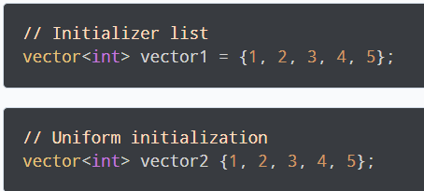
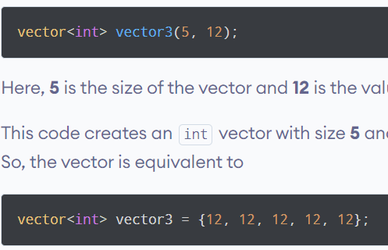
Vector Declarations & Initializations
#include <vector>
std::vector<T> vector_name;
vector<int> num;

Slide 118
#include <iostream>
#include <vector>
using namespace std;
int main() {
vector<int> vector1 = {1, 2, 3, 4, 5}; // initializer list
vector<int> vector2{6, 7, 8, 9, 10}; // uniform initialization
vector<int> vector3(5, 12); // method 3
cout << "vector1 = ";
// ranged loop
for (int i : vector1)
{ cout << i << " "; }
cout << "\nvector2 = ";
// ranged loop
for (int i : vector2)
{ cout << i << " "; }
cout << "\nvector3 = ";
// ranged loop
for (int i : vector3)
{ cout << i << " "; }
return 0; }
Initialize & print Elements of a vector

Slide 119
#include <iostream>
#include <vector>
using namespace std;
int main()
{
vector<int> num {1, 2, 3, 4, 5};
cout << "Initial Vector: ";
for (int i : num)
{ cout << i << " "; }
// add the integers 6 and 7 to the vector
num.push_back(6);
num.push_back(7);
cout << "\nUpdated Vector: ";
for (int i : num)
{ cout << i << " "; }
return 0;
}
#include <iostream>
#include <vector>
using namespace std;
int main()
{ vector<int> num {1, 2, 3, 4, 5};
cout<<"Element at Index 0: "<<num.at(0) << endl;
cout<<"Element at Index 2: "<<num.at(2) << endl;
cout<<"Element at Index 4: "<<num.at(4) << endl;
cout<<"Element at Index 0: "<<num[0] << endl;
cout<<"Element at Index 2: "<<num[2] << endl;
cout<<"Element at Index 4: "<<num[4] << endl;
return 0;
}
Add & Access Elements to & from a vector

Slide 120
#include <iostream>
#include <vector>
using namespace std;
int main() {
vector<int> num {1, 2, 3, 4, 5};
cout << "Initial Vector: ";
for (int i : num)
{ cout << i << " "; }
// change elements at indexes 1 and 4
num.at(1) = 9;
num.at(4) = 7;
cout << "\nUpdated Vector: ";
for (int i : num)
{ cout << i << " "; }
return 0;
}
#include <iostream>
#include <vector>
using namespace std;
int main() {
vector<int> prime_numbers{2, 3, 5, 7};
// initial vector
cout << "Initial Vector: ";
for (int i : prime_numbers)
{ cout << i << " "; }
// remove the last element
prime_numbers.pop_back();
// final vector
cout << "\nUpdated Vector: ";
for (int i : prime_numbers)
{ cout << i << " "; }
return 0;
}
Change & delete the vector Elements

Slide 121
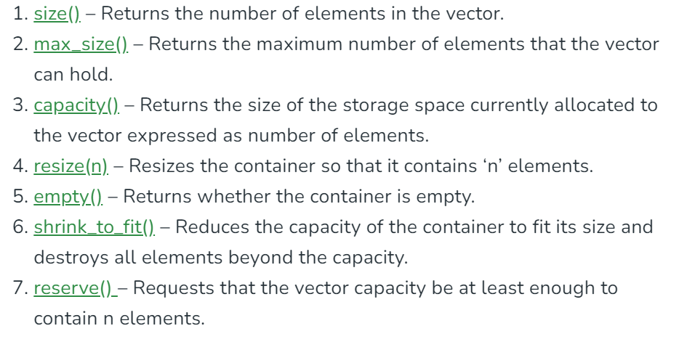

Slide 122
Size and Capacity
#include <iostream>
#include <vector>
using namespace std;
int main()
{
vector<int> v;
cout << "Initial capacity: " << v.capacity() << endl;
for(int i = 0; i != 20; ++i)
{
v.push_back(i);
cout << "Size " << v.size() << " capacity: " << v.capacity() << endl;
}
return 0;
}

Slide 123
// C++ program to illustrate the capacity function in vector
#include <iostream>
#include <vector>
using namespace std;
int main()
{
vector<int> g1;
for (int i = 1; i <= 5; i++)
g1.push_back(i);
cout << "Size : " << g1.size();
cout << "\nCapacity : " << g1.capacity();
cout << "\nMax_Size : " << g1.max_size();
// resizes the vector size to 4
g1.resize(4);
// prints the vector size after resize()
cout << "\nSize : " << g1.size();
// checks if the vector is empty or not
if (g1.empty() == false)
cout << "\nVector is not empty";
else
cout << "\nVector is empty";
// Shrinks the vector
g1.shrink_to_fit();
cout << "\nVector elements are: ";
for (auto it = g1.begin(); it != g1.end(); it++)
cout << *it << " ";
return 0;
}

Slide 124
Iterators
begin()– Returns an iterator pointing to the first element in the vector
end()– Returns an iterator pointing to the theoretical element that follows the last element in the vector
rbegin()– Returns a reverse iterator pointing to the last element in the vector (reverse beginning). It moves from last to first element
rend() – Returns a reverse iterator pointing to the theoretical element preceding the first element in the vector (considered as reverse end)
cbegin() – Returns a constant iterator pointing to the first element in the vector.
cend() – Returns a constant iterator pointing to the theoretical element that follows the last element in the vector.

Slide 125
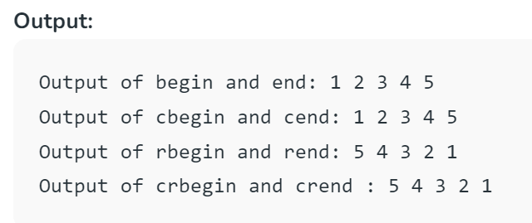
// C++ program to illustrate the iterators in vector
#include <iostream>
#include <vector>
using namespace std;
int main()
{
vector<int> g1;
for (int i = 1; i <= 5; i++)
g1.push_back(i);
cout << "Output of begin and end: ";
for (auto i = g1.begin(); i != g1.end(); ++i)
cout << *i << " ";
cout << "\nOutput of cbegin and cend: ";
for (auto i = g1.cbegin(); i != g1.cend(); ++i)
cout << *i << " ";
cout << "\nOutput of rbegin and rend: ";
for (auto ir = g1.rbegin(); ir != g1.rend(); ++ir)
cout << *ir << " ";
cout << "\nOutput of crbegin and crend : ";
for (auto ir = g1.crbegin(); ir != g1.crend(); ++ir)
cout << *ir << " ";
return 0;
}

Slide 126
File I/O in C++

Slide 127
Using Input/Output Files
A computer file:
is stored on a secondary storage device (e.g., disk);
is permanent;
can be used to
provide input data to a program
or receive output data from a program
or both;
should reside in Project directory for easy access;
must be opened before it is used.

Slide 128
General File I/O Steps
Include the header file fstream in the program.
Declare file stream variables.
Associate the file stream variables with the input/output sources.
Open the file
Use the file stream variables with >>, <<, or other input/output functions.
Close the file.

Slide 129
Using Input/Output Files
stream - a sequence of characters
interactive (iostream)
• cin - input stream associated with keyboard.
cout - output stream associated with display
file (fstream)
• ifstream - defines new input stream (normally associated with a file).
• ofstream - defines new output stream (normally associated with a file).

Slide 130
Stream I/O Library Header Files
Note: There is no “.h” on standard header files : <fstream>
iostream -- contains basic information required for all stream I/O operations
fstream -- contains information for performing file I/O operations

Slide 131
C++ streams
//Add additional header files you use
#include <fstream>
int main ()
{ /* Declare file stream variables such as
the following */
ifstream fsIn;//input
ofstream fsOut; // output
fstream both //input & output
//Open the files
fsIn.open("prog1.txt"); //open the input file
fsOut.open("prog2.txt"); //open the output file
//Code for data manipulation
.
.
//Close files
fsIn.close();
fsOut.close();
return 0; }

Slide 132
Object and Member Functions
Member Function
Name
Stream handle
Name
input_stream.open("numbers.txt“)
File Name
Dir:\\folder\fileName.extention
Extention ( .dat, .out, .txt)
Calling
Object
Dot
Operator

Slide 133
Open()
Opening a file associates a file stream variable declared in the program with a physical file at the source, such as a disk.
In the case of an input file:
the file must exist before the open statement executes.
If the file does not exist, the open statement fails and the input stream enters the fail state
An output file does not have to exist before it is opened;
if the output file does not exist, the computer prepares an empty file for output.
If the designated output file already exists, by default, the old contents are erased when the file is opened.

Slide 134
Validate the file before trying to access
First method
Second method
By checking the stream variable;
If ( ! Mystream)
{
Cout << “Cannot open file.\n ”;
}
By using bool is_open() function.
If ( ! Mystream.is_open()) {
Cout << “File is not open.\n ”;
}

Slide 135
File I/O Example: Open the file with validation
First Method (use the constructor)
Second Method ( use Open function)
#include <fstream>
using namespace std;
int main()
{
//declare output file variable
ofstream outFile;
// open an exist file fout.txt
outFile.open(“fout.txt”);
// Open validation
if(! outFile.is_open() ) {
Cout << “Cannot open file.\n ”;
return 1;
}
return 0;
}
#include <fstream>
using namespace std;
int main()
{
//declare and automatically open the file
ofstream outFile(“fout.txt");
// Open validation
if(! outFile) {
Cout << “Cannot open file.\n ”;
return 1;
}
return 0;
}
Notes:
This program will create the file fout.txt in the directory from where you are executing it, and will put “Hello, world!” into it.
Here is what every line means:
#include <fstream> - You need to include this file in order to use C++’s functions for File I/O.
In this file, are declared several classes, including ifstream, ofstream and fstream, which are all derived from istream and ostream.
ofstream outFile(“cpp-home.txt”);
ofstream means “output file stream”. It creates a handle for a stream to write in a file.
outFile – that’s the name of the handle. You can pick whatever you want!
(“fout.txt”); - opens the file fout.txt, which should be placed in the directory from where you execute the program. If such a file does not exists, it will be created for you, so you don’t need to worry about that!
Now, let’s look a bit deeper. First, I’d like to mention that ofstream is a class. So, ofstream outFile(“fout.txt”); creates an object from this class. What we pass in the brackets, as parameter, is actually what we pass to the constructor. It is the name of the file. So, to summarize: we create an object from class ofstream, and we pass the name of the file we want to create, as an argument to the class’ constructor. There are other things, too, that we can pass, but I will look into that, later.
outFile<< “Hello World,!”; - “<<” looks familiar? Yes, you’ve seen it in cout <<. This (“<<”) is a predefined operator. Anyway, what this line makes, is to put the text above in the file. As mentioned before, outFile is a handle to the opened file stream. So, we write the handle name, << and after it we write the text in inverted commas. If we want to pass variables instead of text in inverted commas, just pass it as a regular use of the cout <<. This way:
outFile << variablename;
That’s it!
outFile.close(); - As we have opened the stream, when we finish using it, we have to close it. outFile is an object from class ofstream, and this class (ofstream) has a function that closes the stream. That is the close() function. So, we just write the name of the handle, dot and close(), in order to close the file stream! Notice: Once you have closed the file, you can’t access it anymore, until you open it again.

Slide 136
More Input File-Related Functions
ifstream fsin;
fsin.open(const char[] fname)
connects stream fsin to the external file fname.
fsin.get(char character)
extracts next character from the input stream fsin and places it in the character variable character.
fsin.eof()
tests for the end-of-file condition.

Slide 137
File I/O Example: Reading
Read char by char
Read a line
#include <iostream>
#include <fstream>
int main()
{//Declare and open a text file
ifstream openFile("data.txt");
char ch;
//do until the end of file
while( ! OpenFile.eof() )
{
OpenFile.get(ch); // get one character
cout << ch; // display the character
}
OpenFile.close(); // close the file
return 0;
}
#include <iostream>
#include <fstream>
#include <string>
int main()
{//Declare and open a text file
ifstream openFile("data.txt");
string line;
while(!openFile.eof())
{//fetch line from data.txt and put it in a string
getline(openFile, line);
cout << line;
}
openFile.close(); // close the file
return 0; }

Slide 138
More Output File-Related Functions
ofstream fsOut;
fsOut.open(const char[] fname)
connects stream fsOut to the external file fname.
fsOut.put(char character)
inserts character character to the output stream fsOut.
fsOut.eof()
tests for the end-of-file condition.

Slide 139
File I/O Example: Writing
Second Method ( use Open function)
First Method (use the constructor)
#include <fstream>
using namespace std;
int main()
{/* declare and automatically open the file*/
ofstream outFile("fout.txt");
//behave just like cout, put the word into the file
outFile << "Hello World!";
outFile.close();
return 0;
}
#include <fstream>
using namespace std;
int main()
{// declare output file variable
ofstream outFile;
// open an exist file fout.txt
outFile.open("fout.txt”);
//behave just like cout, put the word into the file
outFile << "Hello World!";
outFile.close();
return 0;
}
Notes:
This program will create the file fout.txt in the directory from where you are executing it, and will put “Hello, world!” into it.
Here is what every line means:
#include <fstream> - You need to include this file in order to use C++’s functions for File I/O.
In this file, are declared several classes, including ifstream, ofstream and fstream, which are all derived from istream and ostream.
ofstream outFile(“cpp-home.txt”);
ofstream means “output file stream”. It creates a handle for a stream to write in a file.
outFile – that’s the name of the handle. You can pick whatever you want!
(“fout.txt”); - opens the file fout.txt, which should be placed in the directory from where you execute the program. If such a file does not exists, it will be created for you, so you don’t need to worry about that!
Now, let’s look a bit deeper. First, I’d like to mention that ofstream is a class. So, ofstream outFile(“fout.txt”); creates an object from this class. What we pass in the brackets, as parameter, is actually what we pass to the constructor. It is the name of the file. So, to summarize: we create an object from class ofstream, and we pass the name of the file we want to create, as an argument to the class’ constructor. There are other things, too, that we can pass, but I will look into that, later.
outFile<< “Hello World,!”; - “<<” looks familiar? Yes, you’ve seen it in cout <<. This (“<<”) is a predefined operator. Anyway, what this line makes, is to put the text above in the file. As mentioned before, outFile is a handle to the opened file stream. So, we write the handle name, << and after it we write the text in inverted commas. If we want to pass variables instead of text in inverted commas, just pass it as a regular use of the cout <<. This way:
outFile << variablename;
That’s it!
outFile.close(); - As we have opened the stream, when we finish using it, we have to close it. outFile is an object from class ofstream, and this class (ofstream) has a function that closes the stream. That is the close() function. So, we just write the name of the handle, dot and close(), in order to close the file stream! Notice: Once you have closed the file, you can’t access it anymore, until you open it again.

Slide 140
File Open Mode
Name | Description
ios::in | Open file to read
ios::out | Open file to write
ios::app | All the data you write, is put at the end of the file. It calls ios::out
ios::ate | All the data you write, is put at the end of the file. It does not call ios::out
ios::trunc | Deletes all previous content in the file. (empties the file)
ios::nocreate | If the file does not exists, opening it with the open() function gets impossible.
ios::noreplace | If the file exists, trying to open it with the open() function, returns an error.
ios::binary | Opens the file in binary mode.

Slide 141
File Open Mode
#include <fstream>
int main(void)
{
ofstream outFile("file1.txt", ios::out);
outFile << "That's new!\n";
outFile.close();
Return 0;
}
If you want to set more than one open mode, just use the OR operator- |. This way:
ios::ate | ios::binary

Slide 142
Summary of Input File-Related Functions
#include <fstream>
ifstream fsIn;
fsIn.open(const char[] fname)
connects stream fsIn to the external file fname.
fsIn.get(char& c)
extracts next character from the input stream fsIn and places it in the character variable c.
fsIn.eof()
tests for the end-of-file condition.
fsIn.close()
disconnects the stream and associated file.
fsIn >> c; //Behaves just like cin

Slide 143
Summary of Output File-Related Functions
#include <fstream>
ofstream fsOut;
fsOut.open(const char[] fname)
connects stream fsOut to the external file fname.
fsOut.put(char c)
inserts character c to the output stream fsOut.
fsOut.eof()
tests for the end-of-file condition.
fsOut.close()
disconnects the stream and associated file.
fsOut << c; //Behaves just like cout

Slide 144
File format
In c++ files we (read from/ write to) them as a stream of characters
What if I want to write or read numbers ?

Slide 145
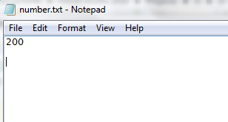
Example writing to file
#include <iostream>
#include <fstream>
using namespace std;
void main()
{
ofstream outFile;
// open an exist file fout.txt
outFile.open("number.txt",ios::app);//ios::app == Append
if (!outFile.is_open())
{ cout << " problem with opening the file ";}
else
{outFile <<200 <<endl ;
cout << "done writing" <<endl;}
outFile.close();
}

Slide 146
Example Reading from file
#include <iostream>
#include <fstream>
#include <string>
#include <sstream>
using namespace std;
void main()
{//Declare and open a text file
ifstream INFile("number.txt");
string line;
int total=0;
while(! INFile.eof())
{
getline(INFile, line);
//converting line string to int
stringstream(line) >> total;
cout << line <<endl;
cout <<total +1<<endl;}
INFile.close(); // close the file
}

Slide 147
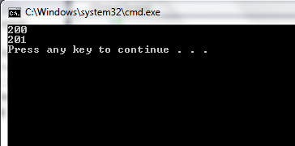

Slide 148
Pointers
Renu Balyan

Slide 149
Pointers
A pointer is a reference to another variable (memory location) in a program
or
A Pointer is variable whose value is a memory address.
Used to change variables inside a function (reference parameters)
Used to remember a particular member of a group (such as an array)
Used in dynamic (on-the-fly) memory allocation (especially of arrays)
Used in building complex data structures (linked lists, stacks, queues, trees, etc.)

Slide 150
Pointers
The * and & operators
- & operator is the address operator
- * operator is the dereferencing operator. It is used in
pointers declaration

Slide 151
Pointer Variable Declaration
Basic syntax: <type> *variable_Name
Examples:
int *P; /* P is var that can point to an int var */
float *Q; /* Q is a float pointer */
char *R; /* R is a char pointer */
void * yPtr; // yPtr is a generic pointer, represents any type
Complex example:
int *AP[5]; /* AP is an array of 5 pointers to ints */
more on how to read complex declarations later

Slide 152
Address (&) Operator
The address (&) operator can be used in front of any variable object -- the result of the operation is the location in memory of the variable
Syntax: &VariableReference
Examples:
int V;
int *P;
int A[5];
&V - memory location of integer variable V
&(A[2]) - memory location of array element 2 in array A
&P - memory location of pointer variable P

Slide 153
Pointer Basics
Variables are allocated at addresses in computer memory (address depends on computer/operating system)
Name of the variable is a reference to that memory address
A pointer variable contains a representation of an address of another variable (P is a pointer variable in the following):

Slide 154
Pointer Assignment
Assignment can be applied on pointers of the same type
If not the same type, a cast operator must be used
Exception: pointer to void does not need casting to convert a pointer to void type
void pointers cannot be dereferenced
Example
int *xPtr, *yPtr; int x = 5;
…
xPtr = & x; // xPtr now points to address of x
yPtr = xPtr; // now yPtr and xPtr point to x

Slide 155
Indirection (*) Operator
A pointer variable contains a memory address
To refer to the contents of the variable that the pointer points to, we use indirection operator
Syntax: *PointerVariable
Example:
int V = 101;
int *P = &V;
/* Then *P would refer to the contents of the variable V (in this case, the integer 101) */
cout<<*P; /* Prints 101 */

Slide 156
Pointer Sample
int A = 3;
int B;
int *P = &A;
int *Q = P;
int *R = &B;
Cout<<“Enter value:“;
Cin>>R;
Cout<<A<<“ and “<<B;
Cout<<*P<<“ “<<*Q<<“ “<<*R;
Q = &B;
if (P == Q)
cout<<“1”<<endl;
if (Q == R)
cout<<“2”<<endl;
if (*P == *Q)
cout<<“3”<<endl;
if (*Q == *R)
cout<<“4”<<endl;
if (*P == *R)
cout<<“5”<<endl;

Slide 157
Pointer Arithmetic
Increment / decrement pointers ( ++ or -- )
Add / subtract an integer to/from a pointer
( + or += , - or -= )
Pointers may be subtracted from each other
Pointer arithmetic is meaningless unless performed on an array

Slide 158
Pointer Arithmetic
Example
Consider an integer array of 5 elements on a machine using 4 bytes for integers.
1000 1004 1008 1012 1016
Pointer variable vPtr
vPtr pointes to first element V[0] (location 1000)
i.e. vPtr = 1000
vPtr +=2; sets vPtr to 1008
i.e. vPtr points to V[2]
V[0] | V[1] | V[2] | V[3] | V[4]

Slide 159
Pointer Arithmetic (Cont.)
Subtracting pointers
- Returns the number of elements between two
addresses
e.g. if v is an array and
vPtr1 = v[0];
vPtr2 = v[2];
then vPtr2 – vPtr1 = 2 (i.e. 2 addresses)

Slide 160
Relations Between Pointers and Arrays
Arrays and pointers are closely related.
- Array name is like constant pointer
- Pointers can do array subscribing operations
- If we declare an array A[4] and a pointer aPtr
• aPtr is equal to A
aPtr == A
• aPtr is equal to the address of the first
element of A
aPtr == & A[0]

Slide 161
Relations Between Pointers and Arrays (Cont.)
Accessing array elements with pointers:
- Element A[i] can be accessed by *(aPtr+i)
• This is called pointer/offset notation
- Array itself can use pointer arithmetic
• A[3] is same as *(A+3)
- Pointers can be subscripted
(i.e. pointer/subscript notation)
• aPtr [3] is same as A[3]

Slide 162
Examples on Pointers
//A program to call a function to swap two numbers using reference parameters
#include <iostream>
using namespace std;
void swap(int *, int *); // This is swap's prototype
int main()
{ int x = 5, y = 7;
swap(&x , &y); // calling swap with reference parameters
cout << "\n x is now "<< x << " and y is now " << y << '\n’;
return 0;
}
// swap function is defined here using dereferencing operator ‘*’
void swap(int *a, int *b)
{ int temp;
temp = *a;
*a = *b;
*b = temp;
}

Slide 163
Examples on Pointers (Cont.)
//A program to test pointers and references
#include <iostream>
using namespace std;
int main ( )
{ int intVar = 10;
int *intPtr; // intPtr is a pointer
intPtr = & intVar;
cout << "\nLocation of intVar: " << & intVar;
cout << "\nContents of intVar: " << intVar;
cout << "\nLocation of intPtr: " << & intPtr;
cout << "\nContents of intPtr: " << intPtr;
cout << "\nThe value that intPtr points to: " << * intPtr;
return 0;
}

Slide 164
When calling, the pointer formal parameter will points to the actual parameter.
#include <iostream>
using namespace std;
void Increment(int*);
int main() {
int A = 10;
Increment(&A);
cout<<A<<endl;
}
void Increment(int *X)
{ ++*X; }

Slide 165
Pointers and Strings
Pointers can be used to declare strings and with string functions
#include <iostream>
using namespace std;
int main(){
char name[ ]= "Sam";
char *p;
p = name; /* for string, only this declaration will store its base address */
while( *p != '\0')
{
cout << *p;
p++;
}
return 0;
}

Slide 166
Passing Strings to Functions
#include <iostream>
using namespace std;
void display( char ch[] )// passing a string
{
cout << ch;
}
int main(){
char arr[30];
cout << "Enter a word" << endl;
cin >> arr;
display(arr);
return 0;
}

Slide 167
Operator Overloading

Slide 168
What is operator overloading?
Changing the definition of an operator so it can be applied on the objects of a class is called operator overloading.
To overload an operator, we need to write a function for the operator we are overloading.

Slide 169
Introduction
Overloading an operator
Write function definition as normal
Function name is keyword operator followed by the symbol for the operator being overloaded
operator+ used to overload the addition operator (+)
Using operators
To use an operator on a class object it must be overloaded unless the assignment operator(=)or the address operator(&)
Assignment operator by default performs member wise assignment
Address operator (&) by default returns the address of an object

Slide 170
Restrictions on Operator Overloading
C++ operators that can be overloaded
C++ Operators that cannot be overloaded

Slide 171
Restrictions on Operator Overloading
Overloading restrictions
Precedence of an operator cannot be changed
Associativity of an operator cannot be changed
Arity (number of operands) cannot be changed
Unary operators remain unary, and binary operators remain binary
Operators &, *, + and - each have unary and binary versions
Unary and binary versions can be overloaded separately
No new operators can be created
Use only existing operators
No overloading operators for built-in types
Cannot change how two integers are added
Produces a syntax error

Slide 172
Operator Functions as Class Members vs. as friend Functions
Member vs non-member
Operator functions can be member or non-member functions
When overloading ( ), [ ], -> or any of the assignment operators, must use a member function
Operator functions as member functions
Leftmost operand must be an object (or reference to an object) of the class
If left operand of a different type, operator function must be a non-member function
Operator functions as non-member functions
Must be friends if needs to access private or protected members
Enable the operator to be commutative

Slide 173
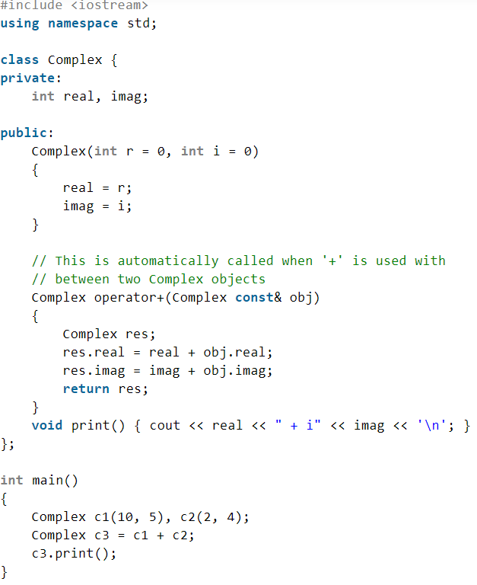

Slide 174
